Slide 1


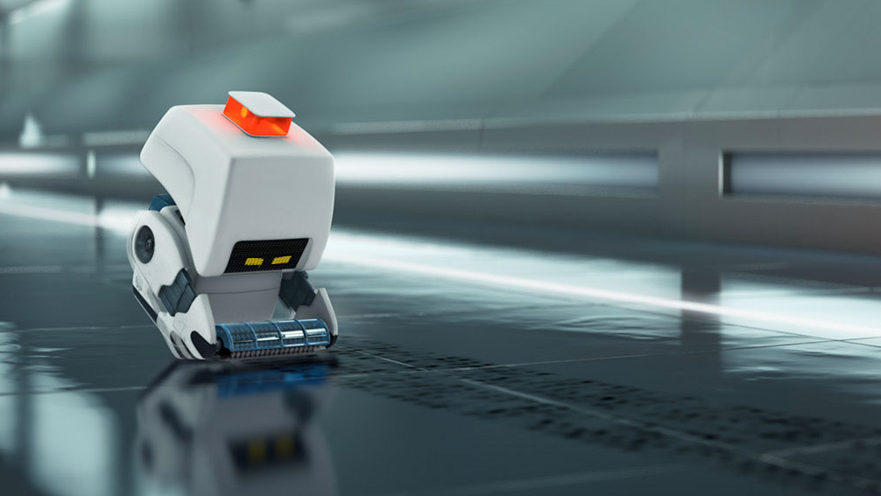
Image Processing: the mind of a Line Following robot
Kaitlyn Colaw, Mason Lee, Camrin Palmer, M. Catherine Yopp

Slide 2
Project Overview
What is image processing?
Pattern Recognition
Line following robot and how it works
Physical bot
Image processing relative to this project
cv2 library use and exploration
Conclusion
Dataset
Why this matters

Slide 3
What is Image Processing?
The process of using a computer program to analyze or edit an image (Kumar).
Image processing is used in photo editing, social media, medical imaging, computer vision, pattern recognition, and video processing (Majumder).

Slide 4
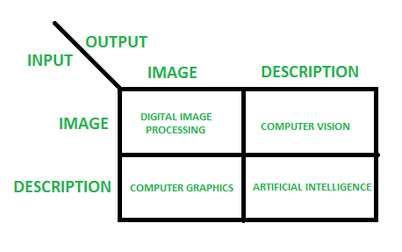
OVERLAPPING FIELDS WITH IMAGE PROCESSING
The type of output determines the type of program used
The focus of this project will primarily be digital image processing

Slide 5
Main Steps for Image Processing
1) Importing image(s) via acquisition tools
2) Analyzing or editing image(s)
3) Output another image or an analysis of the input image(s)

Slide 6
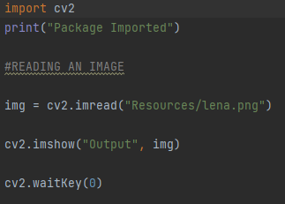
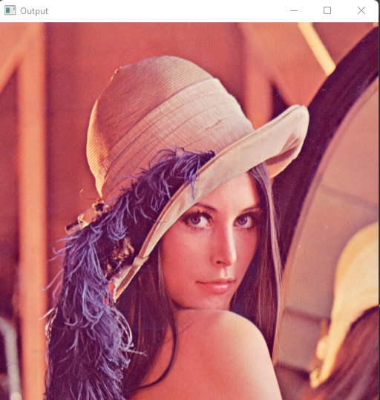
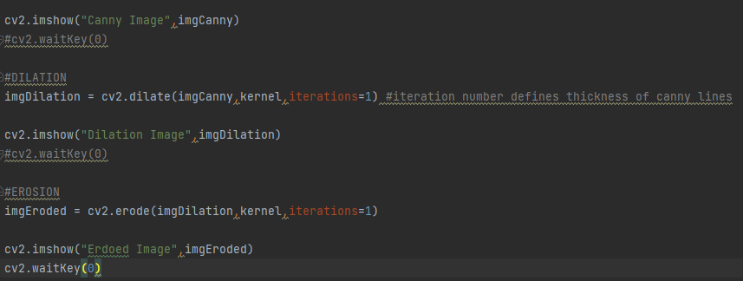
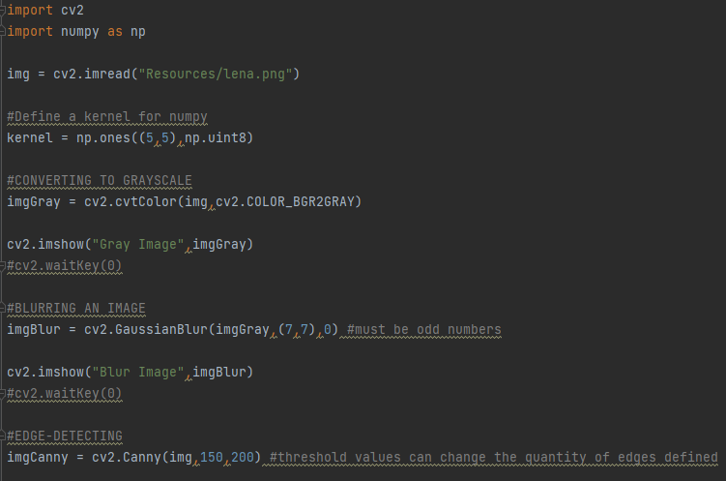
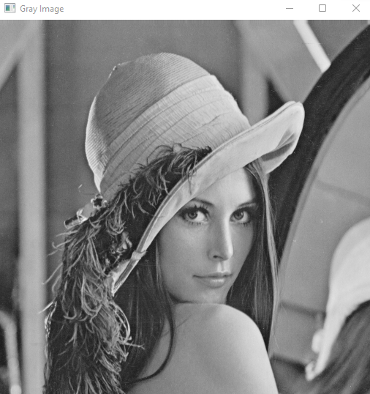
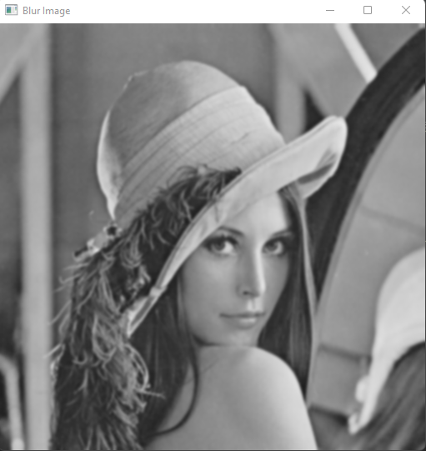
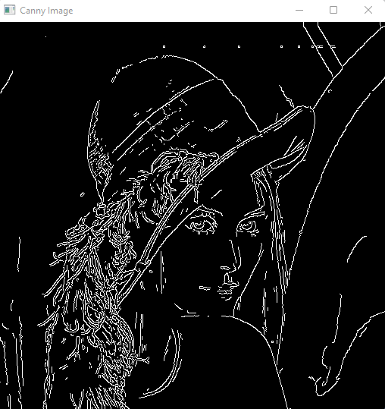
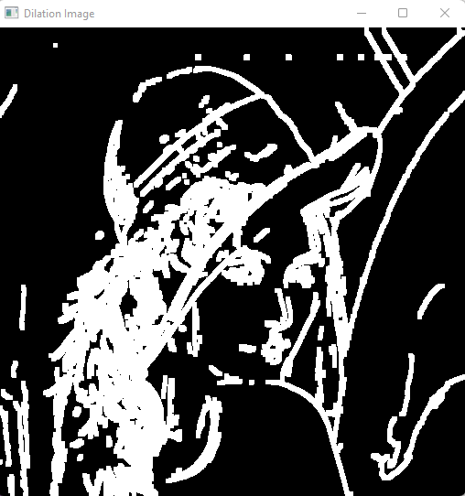
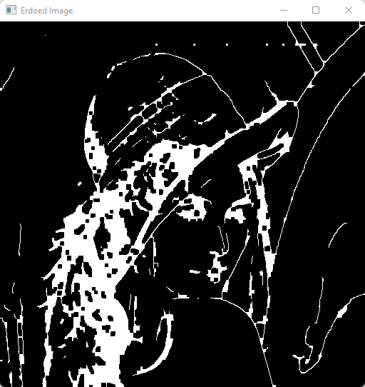
Notes:
Kaitlyn Colaw

Slide 7
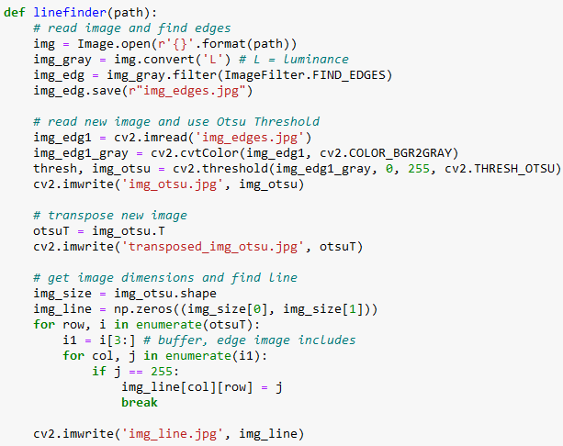

Linefinding

Slide 8
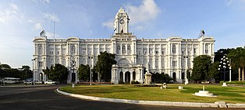

Slide 9
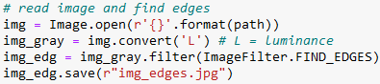
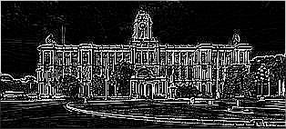

Slide 10
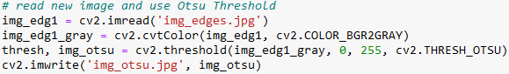
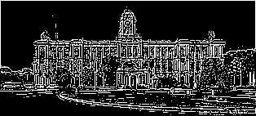

Slide 11
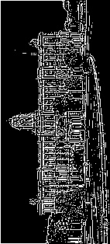
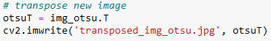

Slide 12
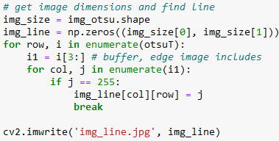


Slide 13
Pattern Recognition
This code utilizes pattern recognition to determine if the robot is “looking” at the path
The code analyzes the path one section at a time until the whole path has been “followed”

Slide 14
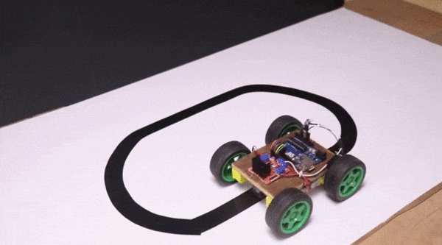
How does a line following robot Operate?

Slide 15
how a physical line following robot works
Has a preloaded dataset of what it’s supposed to be looing at
Captures image of what its looing at and compares to dataset image for that “step”
Adjusts course to move forward until captured image and dataset image match

Slide 16
Dataset
19 images using black lines on white backgrounds and ranging from 0-180 degrees in 10-degree increments and a blank image

Slide 17



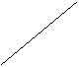



Slide 18
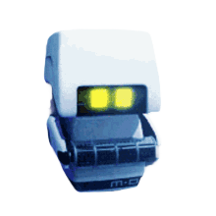
[[135, 76, 74],
[142, 68, 59],
[142, 68, 59],
...,
[247, 246, 242],
[247, 246, 242],
[247, 246, 242]],
[[149, 83, 78],
[135, 76, 74],
[142, 68, 59],
...,
[247, 246, 242],
[247, 246, 242],
[247, 246, 242]],
[[149, 83, 78],
[149, 83, 78],
[135, 76, 74],
...,
[247, 246, 242],
[247, 246, 242],
[247, 246, 242]]], dtype=uint8)
array([[[216, 188, 154],
[216, 188, 154],
[205, 176, 156],
...,
[206, 176, 139],
[206, 176, 139],
[216, 188, 154]],
[[192, 152, 104],
[181, 153, 151],
[179, 137, 152],
...,
[202, 166, 124],
[202, 166, 124],
[202, 166, 124]],
[[149, 83, 78],
[149, 83, 78],
[135, 76, 74],
...,
[202, 166, 124],
[197, 157, 110],
[202, 166, 124]],
...,
‘mo_icon.png’
Convert each image in the dataset to an array of the RGB values of each pixel
Notes:
So how do we import our dataset and make it useable? We have to take in raster images—which are images composed of pixels and not vectors—and convert it into an array of RGB values for each pixel. The dimensions of the array depend on the size of the picture.

Slide 19
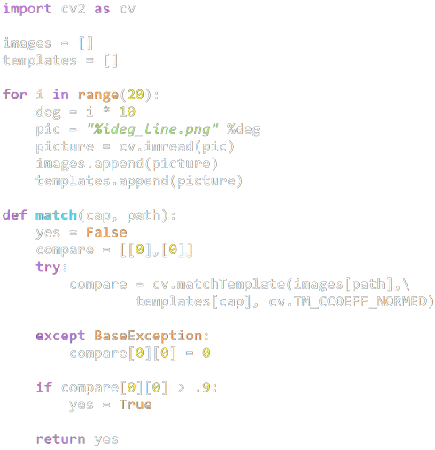
Importing the entire dataset
Discretizing images by pixel rgb colors
Pattern recognition
Why the exception?
Notes:
Now what does this look like translated into code?

Slide 20
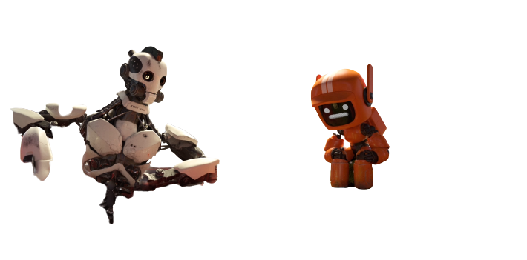
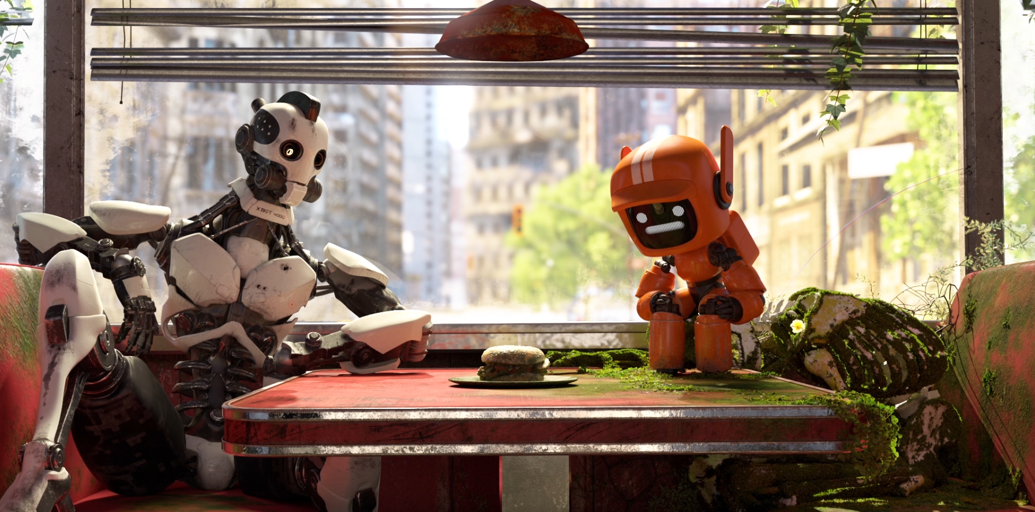

Template
Source
$$R\left(x,y\right)=\frac{\sum_{x^{′},y^{′}}{T^{′}\left(x^{′},y^{′}\right)∗I^{′}\left(x+x^{′}, y+y^{′}\right)}}{\sqrt{\sum_{x^{′},y^{′}}{T^{′}{\left(x^{′},y^{′}\right)}^{2}∗I^{′}{\left(x+x^{′},y+y^{′}\right)}^{2}}}}$$
Result at pixel location on source
Template pixel location
Notes:
cv2.matchTemplate takes the rgb values of the pixles of an image and compares them to the pixels of an image that contains that image within it, the template. The output of the function gives the user an idea of how much the pixel arrangements match the pixel arrangement of the image of interest. To this comparison, the arrays must be the same size and therefore, the image of interest and the template image must be the same size or the code will stop and produce an error. The images aren’t all the same size so an exception must be accounted for so that the code doesn’t immediately break.

Slide 21
Emulated line following robot
Each image in data set will be numbered and indexed
The robot will “capture” an image (randomly select indexed number)
Compare image to what it should be “looking” at
Take “steps” until end of path
Notes:
We are emulating the design of a line following robot without actually building the robot. A physical robot would have cameras that capture what is in front of it and then compare it to a dataset of images of the different angles that the robot could be facing relative to the path that it is supposed to follow. The robot would then try to turn to adjust its angle accordingly and repeat the process of capture and compare. To emulate this process, our “robot” will be fed a number generated by a randomizing function. This number will be associated with a photo from the dataset. The “robot” will then use pattern recognition to compare the image that it is fed to the image associated with the path they are supposed to take. If the images are the same, then the “robot” can move forward and repeat the process. If the images are NOT the same, then the number of the image it was fed is removed from the numbers available in the random number generator and the process is repeated. This emulates the angle adjustment of a physical robot. The removal of an image number from the random number generator ensures that the process for each “step” of the robot can only occur a maximum of 19 times.

Slide 22
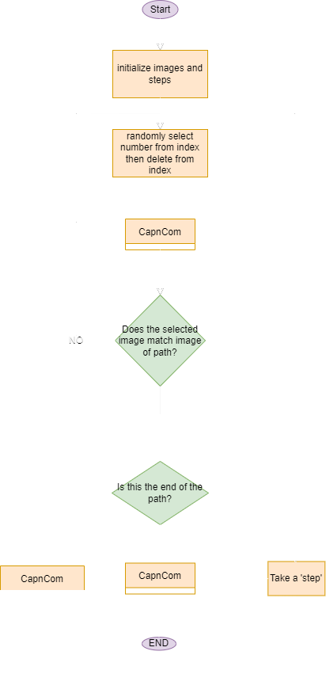


Slide 23
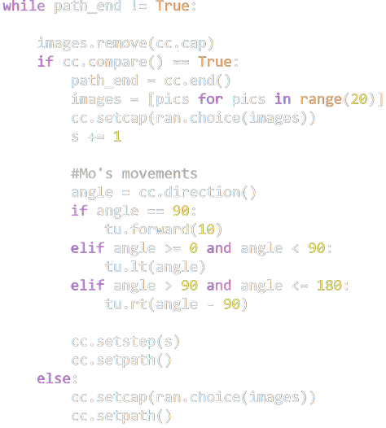
Numbered and Indexed images
“Looking” at the right thing?
Take a “step”
“Capturing” an image

Slide 24
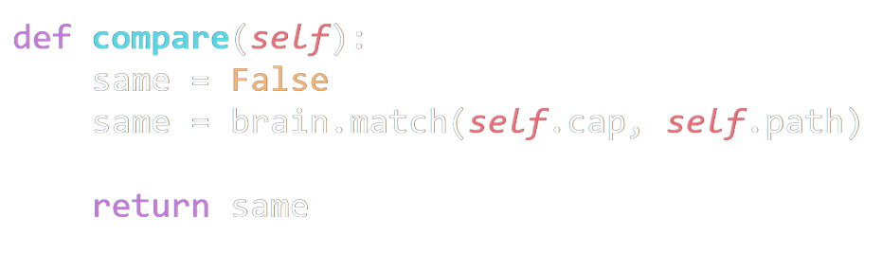
This is the image that Mo is “looking” at
This is the actual image of the path

Slide 25
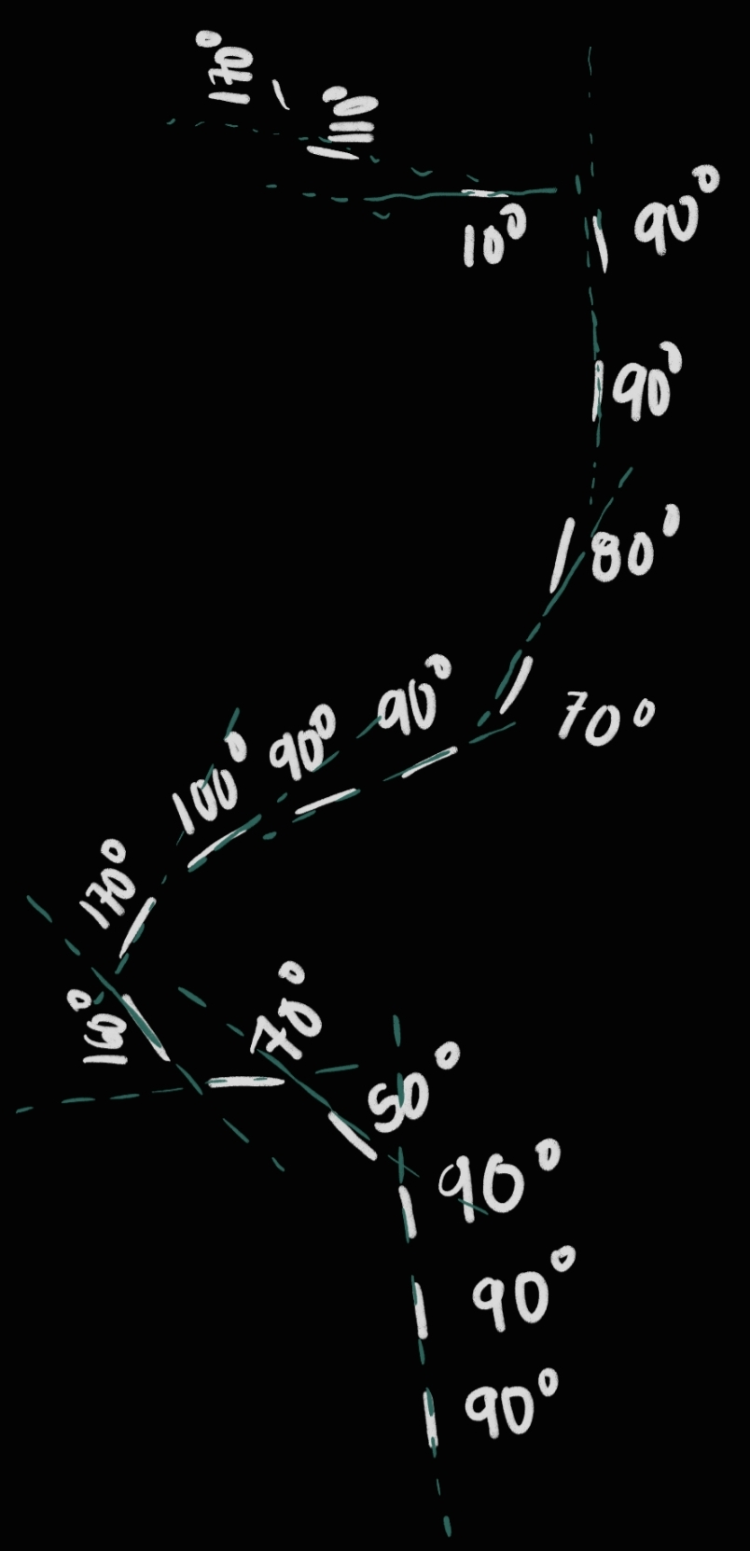
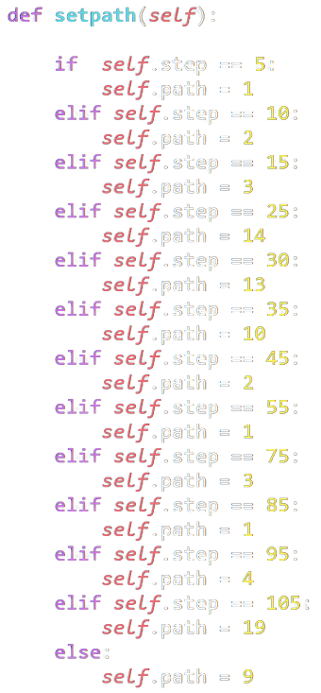

Slide 26
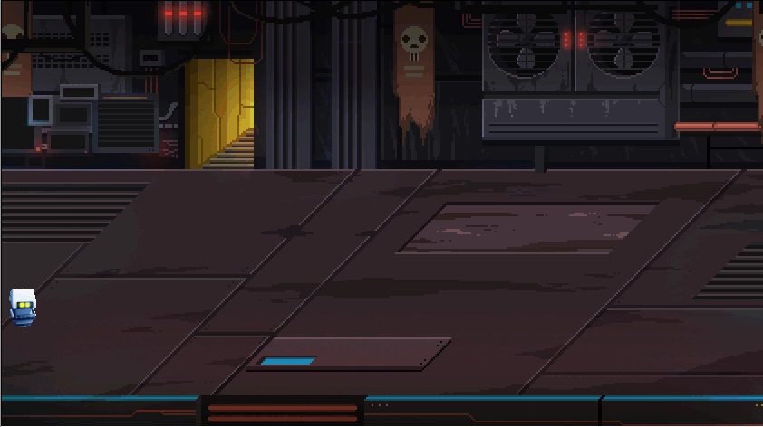

Slide 27
Why Does This Matter?
The image processing used in this program is a scaled-down version of actual coding used in real life.
Pattern recognition is used in facial recognition programs, like your iPhone unlocking when it sees your face or reads your fingerprint
On a larger scale, pattern recognition is used in the design of many identification programs and is therefore valuable in the world today.
Notes:
Kaitlyn Colaw

Slide 28

Questions?

Slide 29
Works Cited
Kumar, N. (2021, November 30). Digital Image Processing Basics. GeeksforGeeks. Retrieved January 26, 2022, from https://www.geeksforgeeks.org/digital-image-processing-basics/
Majumder, P. (2021, May 31). Digital Image Processing Applications: Image processing in python. Analytics Vidhya. Retrieved February 4, 2022, from https://www.analyticsvidhya.com/blog/2021/05/digital-image-processing-real-life-applications-and-getting-started-in-python/

Slide 30
Thank you

